Slide 1
Integration of Classical Features, Social Media Response and Power of Stars to Predict the Box Office Sales
By: Rashika Daga
Mohammed Allama Hossain
Under the guidance of:
Prof. Saptarsi Goswami
Institute of Engineering & Management
International Conference on Telecommunication, Power Analysis and Computing Techniques (ICTPACT – 2017)

Slide 2
Agenda
Motivation
Related Works
Algorithm
Outcome
Challenges
Conclusion
References

Slide 3
Motivation
Predicting the box office success is a contemporary and relevant problem to solve given the size of the Bollywood industry.
Revenues from the Hindi film industry are likely to cross Rs19,300 crores by fiscal 2017.
Actors, investors, producers, financers, directors, etc. should have knowledge about the approximate return before the release of the movie so that they can enhance their promotional activities accordingly based on a concrete analysis.
This explains the importance of research in the movie field.

Slide 4
Related Works
Barry R Litman developed a regression model to depict the financial success of theatrical movies.
Asur and Huberman were the pioneers in correlating the quantitative and qualitative aspects of tweets
Wenbin Zhang and Steven Skiena have incorporated the news data with data obtained from Internet Movie Database (IMDb) to generate the box office revenue.
In paper by Chintagunta, Gopinath and Venkataraman, they have combined the online reviews with the local market feedback and proved that this aggregation gives a better accuracy.
Huan Jianxiong and the other authors in their paper have considered expert reviews, network based peer reviews, and non-network based peer reviews, along with control variables as the classical features and star power.

Slide 5
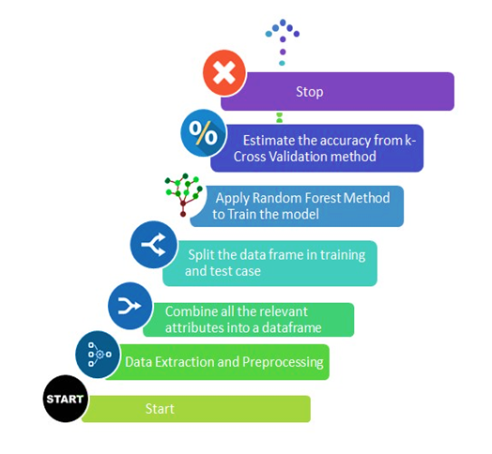
Algorithm

Slide 6


Data Extraction
Extraction of Classical Features from IMDb(Internet Movie Database)
Release Date
Duration
Genre
Actors’ List
Whether movie is a sequel or not
Extraction of Social Media Response(Facebook Likes) using Rfacebook
Get the access token from Facebook API
If the official page of the movie exists, then
insights=getInsights(page_id='221568044327801_754789777921289', token=access_token, metric='page_fans_country', period='lifetime ‘parms='&since=start_date&until=end_date')
Calculate the sum of the values in the column named likes from insights.

Slide 7



Data Extraction (Continued)
Influence of Stars (Times Celebex)
Times Celebex Rating for the actors and actresses 1 month before the release of the movie
Box Office Sales
Total Nett. Gross is retrieved from Book My Show
Holiday Effect
Whether the movie is released on a holiday or not.
The holiday must lie after 1, 2, or 3 days after the release in at least 3 states in India.

Slide 8
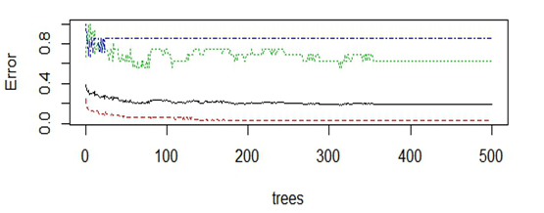
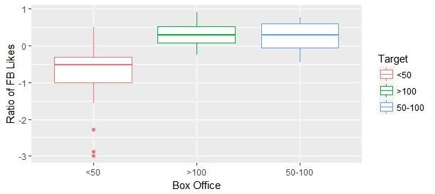
Outcomes
Fig. 1. Graph depicting the error rate across decision tree
Fig. 2. Relationship of Ratio of Facebook Likes and Box Office Range (Social Media Response)

Slide 9
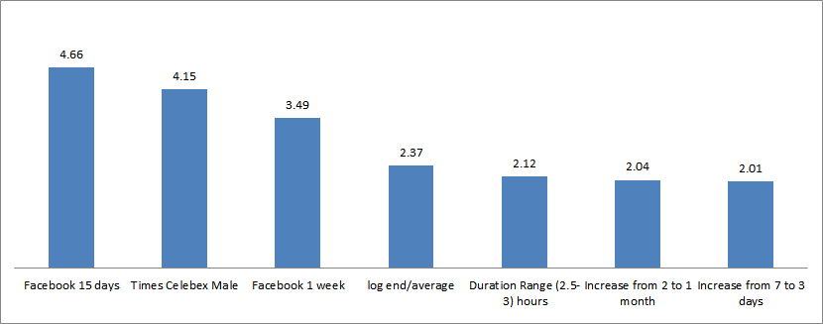
Outcomes (Contd.)
Fig. 3. Bar Graph representing the Mean Decrease in Gini Coefficient of 7 most important variables obtained by Random Forest Method

Slide 10
Challenges
One problem that was faced throughout the research work was the limited availability of data-set and this was because relatively fewer number of movies maintained an official Facebook page.
Also the API does not allow to access data prior to 2 years.

Slide 11
Conclusion
The research work is in a new domain because firstly it integrates various factors like rating of actors, Facebook responses and classical features and secondly the prediction is available before the release of the movie.
Rating of actors turned out to be a very important factor because in several countries, certain actors enjoy a strong fan base which becomes a major deciding factor of the success of a movie.
The random forest model produces a classification accuracy of 87.57% with 5-fold cross validation.

Slide 12
References
Litman, Barry R. "Predicting success of theatrical movies: An empirical study." The Journal of Popular Culture 16, no. 4 (1983): 159-175.
Asur, Sitaram, and Bernardo A. Huberman. "Predicting the future with social media." In Web Intelligence and Intelligent Agent Technology (WI-IAT), 2010 IEEE/WIC/ACM International Conference on, vol. 1, 492-499. IEEE, 2010.
Zhang, Wenbin, and Steven Skiena. "Improving movie gross prediction through news analysis." In Proceedings of the 2009 IEEE/WIC/ACM International Joint Conference on Web Intelligence and Intelligent Agent Technology-Volume 01, pp. 301-304. IEEE Computer Society, 2009.
Chintagunta, Pradeep K., Shyam Gopinath, and Sriram Venkataraman. "The effects of online user reviews on movie box office performance: Accounting for sequential rollout and aggregation across local markets." Marketing Science 29, no. 5 (2010): 944-957.
Huang, Jianxiong, Wai Fong Boh, and Kim Huat Goh. "From A Social Influence Perspective: The Impact Of Social Media On Movie Sales." InPACIS, p. 79. 2011.

